Slide 1
AUTOMATIC APPLE FRUIT DETECTION USING DEEP LEARNING
AUTOMATIDETECTION USING
Presented by,
Hemalatha.S
Jayalakshmi.M
Pooja Mhaske

Slide 2
COMPANY PROFILE
REGIONAL REMOTE SENSING CENTRE-SOUTH, NRSC - ISRO, BANGALORE:
Regional Remote Sensing Centre - South (RRSC-S) is the southern regional node of National Remote Sensing Centre, Hyderabad. Over the past three decades the five Regional Remote Sensing Centers, RRSC-C, RRSC-E, RRSC-N, RRSC-S and RRSC-W, have contributed significantly to major National level applications projects and user projects using geospatial technology.

Slide 3
01
INTRODUCTION
02
ABSTRACT
AGENDA
03
OBJECTIVES
04
PROBLEM STATEMENT
05
TECHNOLOGIES USED
06
METHODOLOGY
07
CONCLUSION

Slide 4
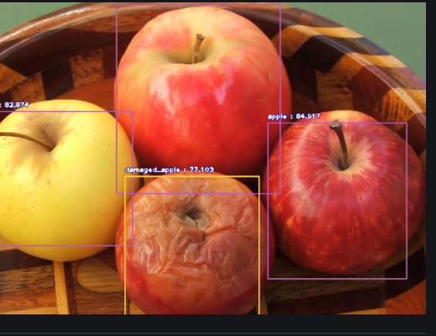
AUTOMATIC APPLE FRUIT DETECTION USING DEEP LEARNING

Slide 5
INTRODUCTION
Computer‌ ‌vision‌ ‌acts‌ ‌as‌ ‌a‌ ‌tool‌ ‌to‌ ‌perceive‌ ‌and‌ ‌grasp‌ ‌knowledge.‌ ‌The‌ ‌three‌ ‌basic‌ ‌works‌ ‌undertaken‌ ‌by‌ ‌a‌ ‌computer‌ ‌vision‌ ‌algorithm‌ ‌include‌ ‌classification,‌ ‌detection‌ ‌and‌ ‌Localization.
One reason for this tremendous growth is the integration of deep convolutional neural network to the field of computer vision. Image classification intends to convert an image to a label.
The process of object detection, another important task in computer vision, points to detect the presence of entire objects within an image.

Slide 6
ABSTRACT
In this project, an efficient approach has been proposed to localize every clearly visible object from an image. For object detection we have processed every input image to overcome several complexities, to achieve better result we use object detection algorithm. We have also implemented Convolution Neural Network based on object detection model i.e YOLO-V3.Fruit Detection model that is very proficient regardless of different limitations such as high and poor image quality, same fruit but different shape, size and color, multiple overlapped fruits. This model is capable of detecting single fruit separately from a set of overlapping fruits. Nevertheless, taking a number of challenges into consideration, our proposed model is capable of detecting fruits from image with a better accuracy and average precision rate.

Slide 7
OBJECTIVES
To overcome the computational expense and to provide more accurate bounding boxes, has introduced the YOLO (You Only Look Once) method.
We proposed a solution to help the people to determine the type of apple more accurately and to predict the type of images of apple.
The quantity and the quality of the images have increased, it leads to both opportunities and challenges in this field.
Images are high quality taken from the top of the earth at varying heights, at varying light conditions for variety of applications. The accuracy of the object detection results can be improved by increasing the count of the images.

Slide 8
PROBLEM STATEMENTS
The problem definition of object detection is to determine where objects are located in a given image (object localization) and which category each object belongs to (object classification). Therefore, the pipeline of traditional object detection models can be mainly divided into three stages: informative region selection, feature extraction, and classification.
We aim to assess deep learning techniques based on convolutional neural network (CNN) for object detection. The beauty of convolutional neural networks is that they do not rely on manually created feature extractors or filters. Rather, they train per se from raw pixel level up to final object categories.

Slide 9
TECHNOLOGIES USED
GOOGLE COLABORATORY
DARKNET
Google Colab is a free cloud service for machine learning education and research. It provides a runtime fully configured for deep learning and free-of-charge access to a robust GPU.
Darknet is the part of the Internet below the private deep web that uses custom software and hidden network superimposed on the architecture of the Internet.
YOLOV3
YOLOv3 is an object detection algorithm (based on neural nets) which can be used detect objects in live videos or static images, it is one of the fastest and accurate object detection method to date. YOLO uses a training set comprised of images and their corresponding bounding boxes (of target objects).

Slide 10
METHODOLOGY
OBJECT DETECTION:
Object detection is the procedure of determining the instance of the class to which the object belongs and estimating the location of the object by outputting the bounding box around the object. Detecting single instance of class from image is called as single class object detection, whereas detecting the classes of all objects present in the image is known as multi class object detection.

Slide 11
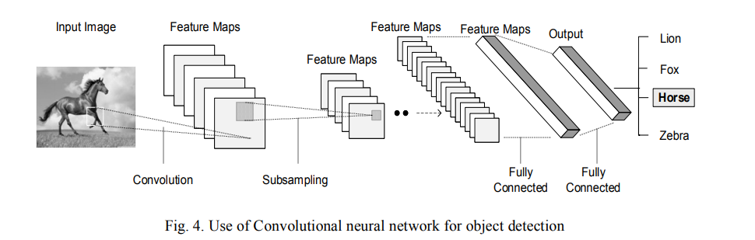
Infographic Style

Slide 12
CONCLUSION
The present approaches are for a vision-based fruit detection system that can detect only a fruit with label. This can be implemented for multiple fruits also. From our point of view one of the main objectives for the future is to improve the accuracy of the neural network. This involves further experimenting with the structure of the network. In the near future we plan to create a mobile application which takes pictures of fruits and labels them accordingly.

Slide 13
THANK YOU

